Slide 1


Slide 2

Topics
What is DNS
IPv4 vs IPv6
Top Level Domains
Domain Registars
Start of Authority (SOA) Record
Name Server (NS)
‘A’ Record
TTL
Canonical Name (CNAME)
Routing policies

Slide 3
What is a DNS?
DNS is like the phonebook
You use the internet you've used DNS is used to convert human friendly domain names (such as http://google.com) into an Internet Protocol(IP) address(such as http://192.162.70.1)
IP addresses are used by computers to identify each other on a network.
IP addresses come into different forms IPv4 and IPv6

Slide 4
IPv4 vs IPv6
IPv4 is a 32-bit field which has over 4 billion different addresses (4,294,967,296)
and essentially it has a finite number of addresses
IPv6 was created to solve this depletion issue and has an address space of 128bits which in theory has
340,282,366,920,938,463,463,374,607,431,768,211,456, or 340 undecillion address

Slide 5
Top Level Domains
If we look at common domain names such as irctc.co.in, google.com, BBC.co.uk etc, you'll notice a string of characters separated by a dots or periods. The last word in a domain name represents the "top level domain".
The second word in a domain name is known as a second level domain name.
And this is optional though and depends on the domain names.
.com
.edu
.gov
.co.in
.gov.in
.com.in

Slide 6
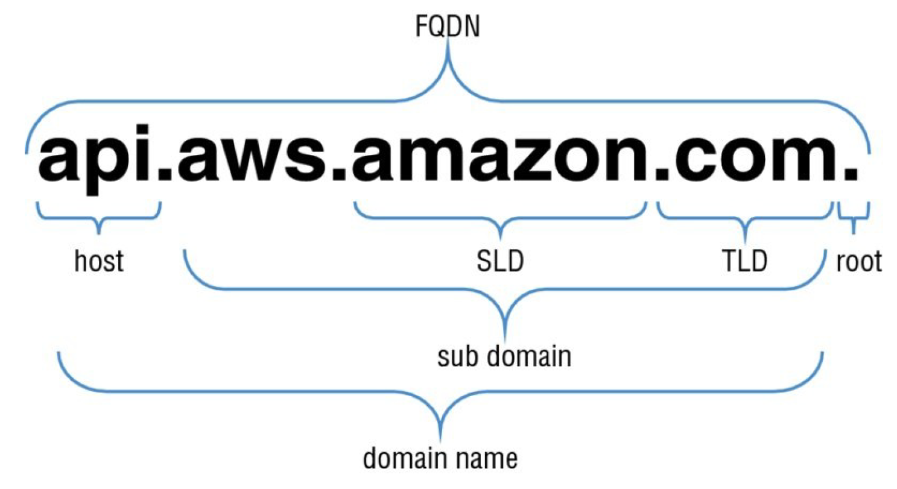
Top Level Domains

Slide 7
Top Level Domains
These domain names are controlled by the Internet Assigned Numbers Authority (IANA) in a root zone database which is essentially a database of all available top-level domains.
You can go and view this database just by visiting :
http://www.iana.org/domains/root/db

Slide 8
Domain Registars
Because all the names in given domain must be unique there needs to be a way of organizing this all so that all domain names aren't duplicated.
This is where domain registrars come in. A registrar is an authority that can assign domain names directly under one or more top level domains. These domains are registered with InterNIC, which is a service of ICANN.
ICAAN basically enforces the uniqueness of domain names across the Internet. Each domain name must be registered in a central database known as a whios is database and popular domain registrars includes
Amazon, GoDaddy.com, google.com

Slide 9
Start of Authority (SOA) Record
The SOA record stores information about the following:
The name of the DNS server for that zone
The administrator of the zone
The current version of the data file
The default TTL value (in seconds) for resource records in the zone

Slide 10


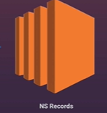

Name Server (NS)
Name Server (NS) records are used by Top level Domain servers to direct traffic to the Content DNS server that contains the authoritative DNS records.
irctc.co.in
SOA
Top Level domain
Irctc.co.in search in NS and return ns.awsdns.com
DNS records

Slide 11
“A” Record
An "A" record is the most fundamental type of DNS record.
The "A" in a record stands for "Address"
The A record is used by a computer to translate the name of the domain to an IP address.
So, for example www.abcd.gov might point to http://121.1.10.92
That's all in a record is it's just like the phone example.

Slide 12
TTL
TTL is length that a DNS record is cached on either the resolving server or the users own local P.C. and it's equal to the value "Time To Live) in seconds
The low the time to live the faster changes to DNS records take to propagate throughout the Internet.
DNS change can take 48 hours to propagate throughout the entire internet

Slide 13
Canonical Name (CNAME)
Canonical Name (CNAME) record is a type of resource record in the DNS that defines an alias for the CNAME for your server (the domain name defined in an A or AAAA record).
It can be used to resolve one domain name to another.
For example, you might have a mobile Web site with the domain name http://m.irctc.co.in and that is used for when your users browse to a domain name on their mobile devices.
You may also want the name http://mobile.irctc.co.in to resolve to the same address and instead of having two separate IP addresses you just map one to the other.

Slide 14
Alias Record
Alias records are used to map resource record sets in your hosted zone to Elastic load balancers, Cloud-front or s3 bucket.
Alias records work like a CNAME record in that you can map one DNS name(www.example.com) to another 'target' DNS name (elb1234.elb.amanzonaws.com)
A CNAME can’t be used for naked domain names(zone apex record). You can’t have a CNAME for irctc.co.in, it must be either an A record or an Alias

Slide 15
Routing policies in Route53
The following Routing policies are available at 53.
Simple Routing.
Weighted Routing.
Latency-base Routing.
Fail over Routing
Geo location Routing.
Geo proximity Routing
Multi value Answer Routing

Slide 16
Health Checks
You can set health checks on individual record sets
If a record set fails a health check it will be removed from Route53 until it passes the health check
You can set SNS notification(email) to alert you if a health check is failed.

Slide 17

Simple Routing
If you choose the simple routing policy, you can only have one record with multiple IP address.
If you specify multiple values in a record, Route 53 returns all values to the user in a random order.
1st
10.1.3.5
2nd
10.1.3.4

Slide 18
Weighted Routing
Allow you split your traffic based on different weights assigned.
For example, you can set 10% of your traffic to go to us-east-1 and 90% to go to ap-south-1
20%
Us-east-1
80%
Ap-south-1

Slide 19
Latency-based Routing
Allows you to route your traffic bases on the lowest network latency for your end user (i.e., which region will give them the fastest response time)
To use latency-based routing, you create a latency resource record set for the Amazon EC2(or ELB) resource in each region that hosts your website.
When Amazon Route 53 receive a query for your site, it selects the latency resource record set
For the region that gives the user the lowest latency. Route 53 then responds with the value associated with that resource record set.

Slide 20
Latency-based Routing
54ms
us-west-1
Us-east-1
300ms
Ap-south-1

Slide 21
Failover Routing
Failover routing policies are used when you went to create an active/passive set-up
For example, you may want your primary site to be in EU-WEST-2 and your secondary DR Site in AP-SOUTHEAST-2
Route53 will monitor the health of your primary site using a health check
A health check monitors the health of your end points

Slide 22
Failover Routing
Active
us-west-1
Us-east-1
Passive
Ap-south-1

Slide 23
Geolocation Routing
Geolocation routing lets you choose where your traffic will be sent based on the geographic location of your users (i.e., the location from which DNS queries originate).
For example, you might want all queries from India to be routed to a fleet of Ec2 instances that are specifically configured for your Indian customers.
These servers may have the local language of your Indian customers and all prices are displayed in INR.

Slide 24
Geolocation Routing
us-west-1
Indian Customer
Us Customer
Ap-south-1

Slide 25
Geo-proximity Routing(Traffic Flow only)
Geo-proximity routing lets Amazon Route 53 route traffic to your resources based on the geographic location of your users and your resources.
You can also optionally choose to route more traffic or less to a given resource by specifying a value, known as a bias.
A bias expands or shrinks the size of geographic region from which traffic is routed to a resource
To use geo-proximity routing, you must use Route53 traffic flow.

Slide 26
Multi-Value Answer
Multi-Value Answer routing lets you configure Amazon Route53 to return multiple values,
such as IP addresses for your web servers, in response to DNS queries.
You can specify multiple values for almost any record, but multi-value answer routing also lets you check the health of each resource,
So, route 53 returns only values for healthy resource
This is like simple routing however it allows you to put health check on each record

Slide 27
Multi-Value Answer
1st
10.1.3.5
2nd
10.1.3.4

Slide 28
Thank you

